Slide 1
Introduction to machine learning
Recap of Session 1
R. Brooks

Slide 2
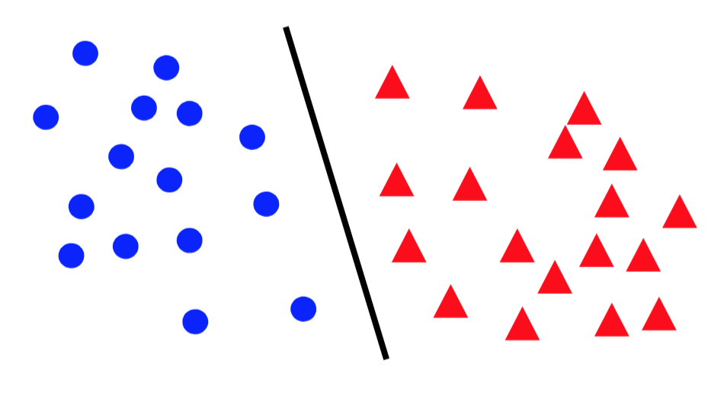
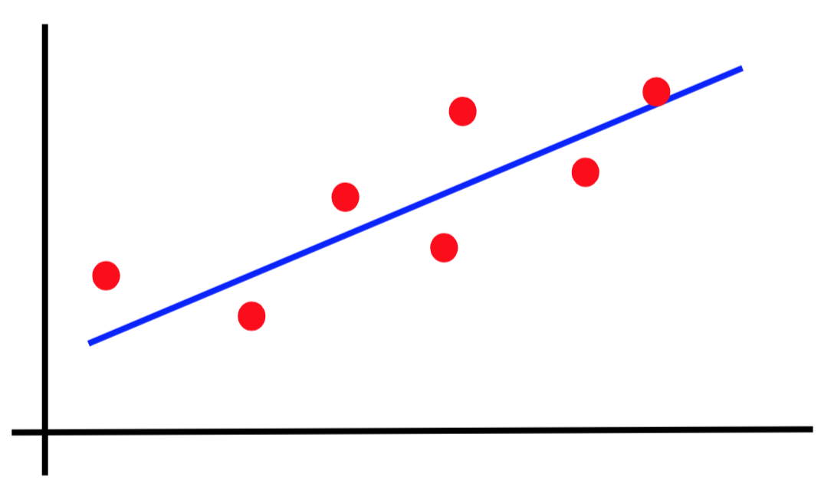
Canonical forms of supervised learning problems
Classification
Regression

Slide 3
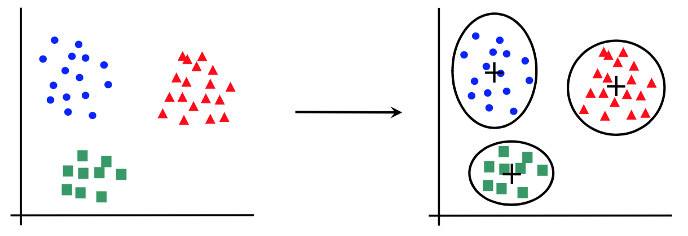
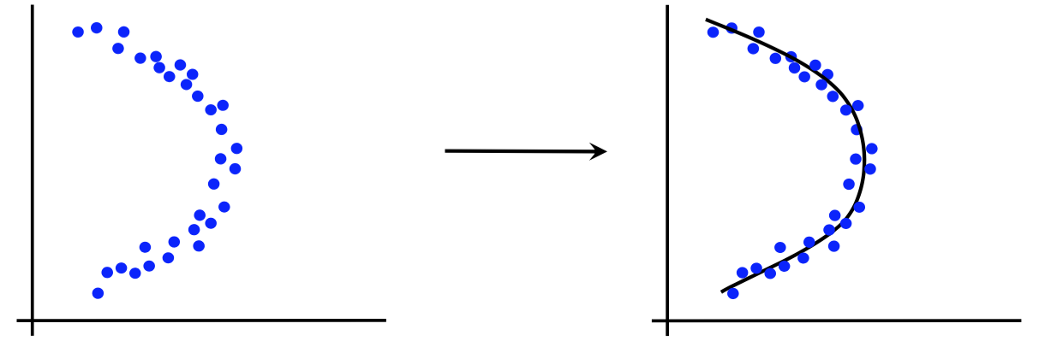
Canonical forms of unsupervised learning problems
Clustering
Dimensionality Reduction

Slide 4
Splitting the data into
training and test
In order to build a model with good generalization capacity, we have to test it on unseen data
First approach (works well when we have enough data):
80% samples for training
20% samples for test
(percentages can vary)

Slide 5
Splitting the data into
training, validation and test
In order to build a model with good generalization capacity, we have to test it on unseen data
First approach (works well when we have enough data):
50% samples for training (or 64%)
25% samples for validation (or 16%)
25% samples for test (or 20%)
(percentages can vary)

Slide 6
Why not just split the data into
training and test?
Repeatedly using the same split when trying different hyperparameters can “wear out” the test set:
We are overfitting in hyperparameter space!
We obtain a better error estimate by tuning the hyperparameters on a (different) validation set

Slide 7
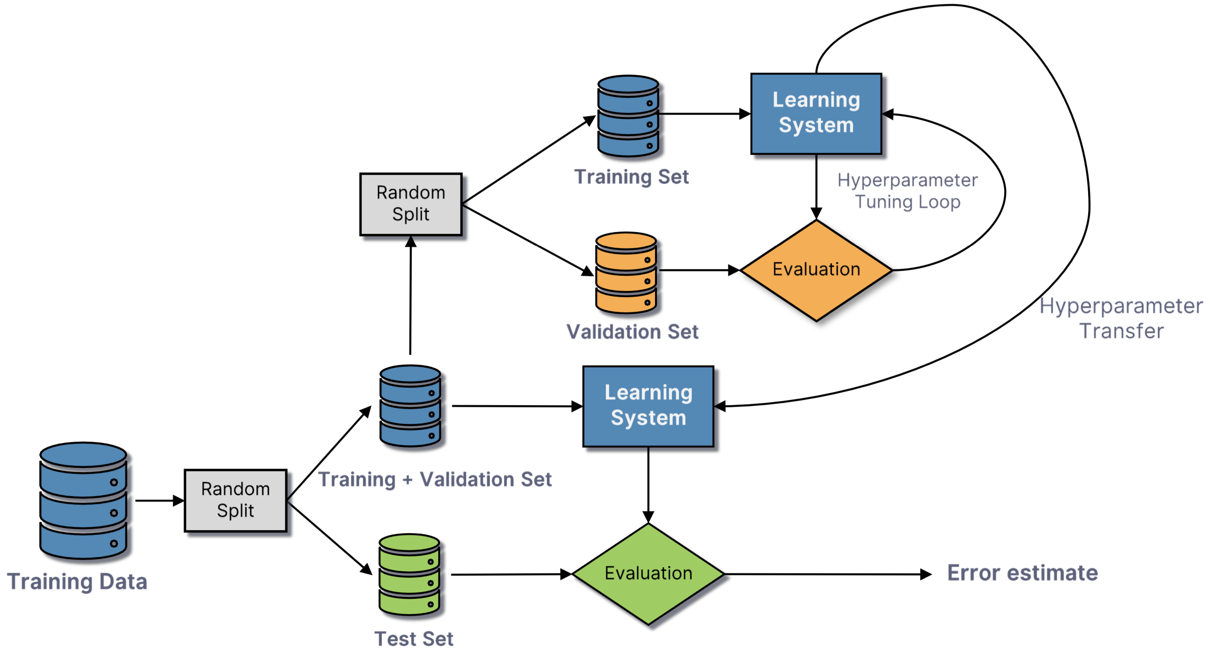
Training, validation, test

